Slide 1

REAL ESTATE BUDDY
RB
REAL ESTATE BUDDY

Slide 2

Abstract
A chatting platform where buyers and sellers meet
Sellers can show case their products, land, buildings etc… and buyers can comment on it shows their view about the project.
With reviews of the previous customers products become more authentic and less chance for cheating.
More like olx, 99 acres platform ,but removed their limitation….

Slide 3
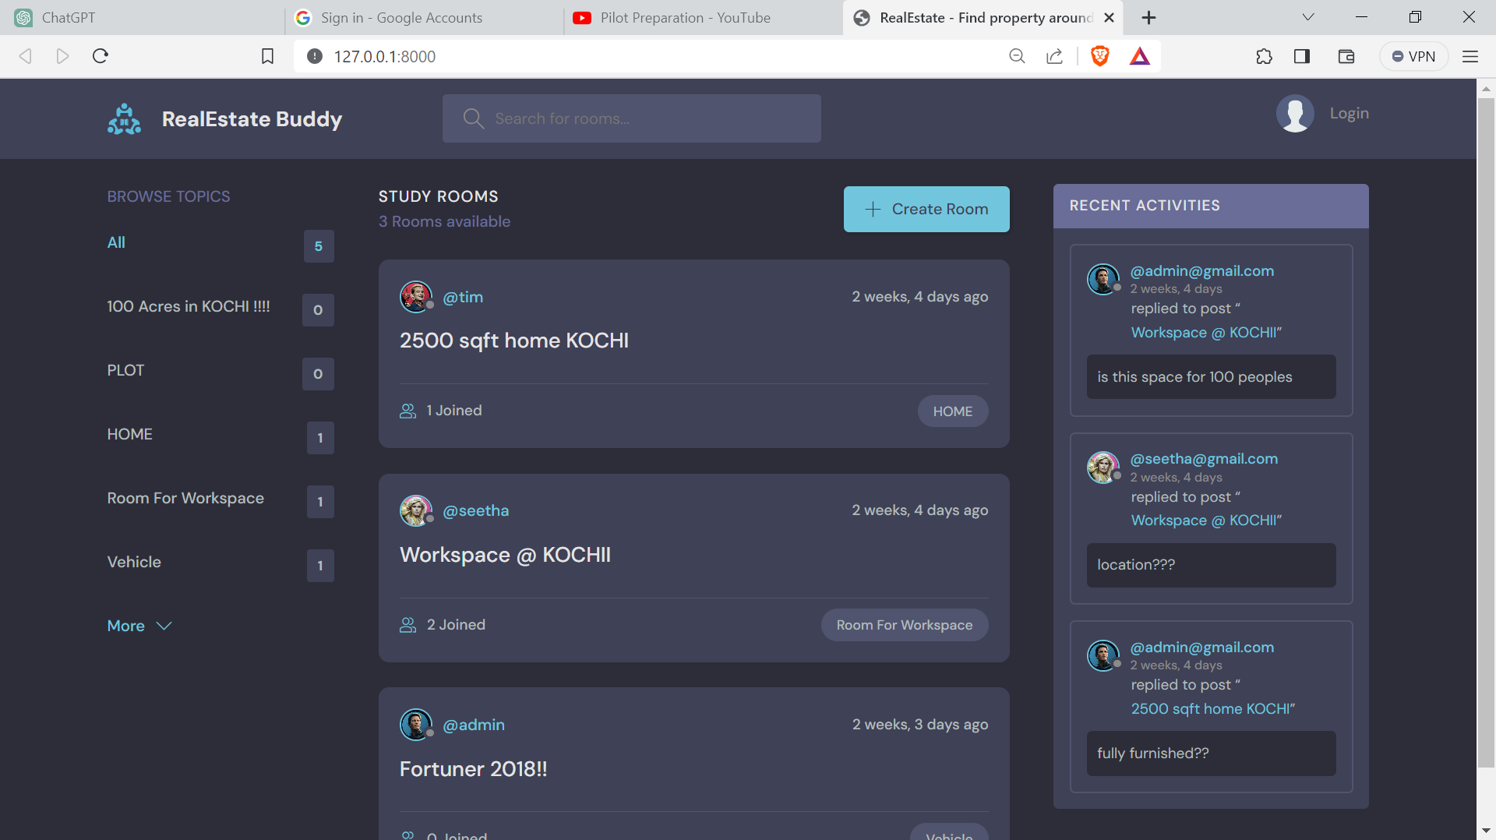
Modules
Home page
Competitive Service
Shows the rooms available
User can interact with interested topics
Sellers can create new topic

Slide 4
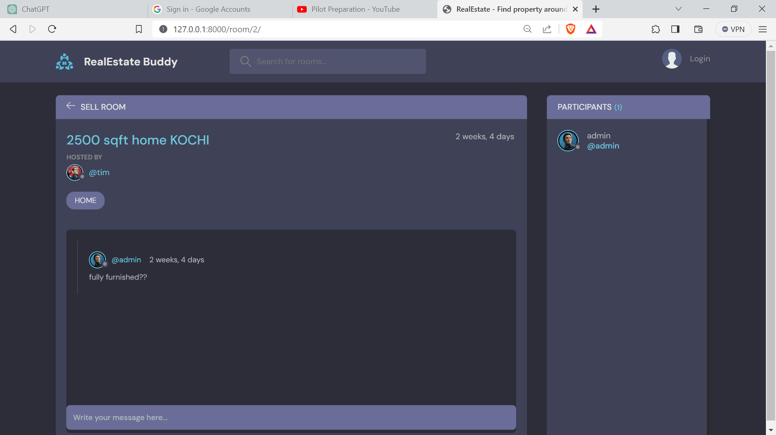
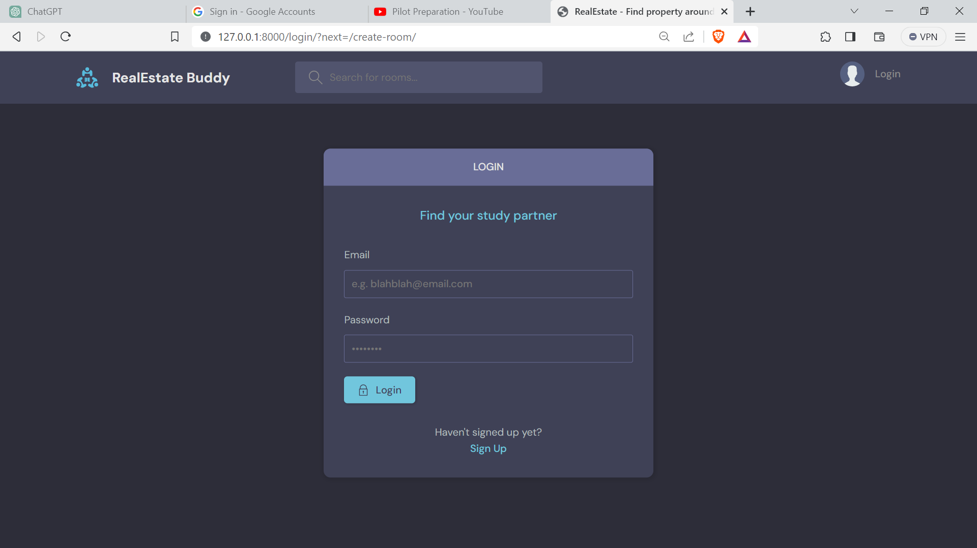

Slide 5
Thank You.
RB
Goutham Harigovind
REAL ESTATE BUDDY
9562278140
gouthamharigovind@gmail.com
github

